Slide 1

7th Grade
Unit 13, Lesson 2 Justifying Measures of Center and Spread Volume 2, pg. 239

Slide 2


Benchmark
MA.7.DP.1.1
Determine an appropriate measure of center or measure of variation to summarize numerical data, represented numerically or graphically, taking into consideration the context and any outliers.
volume 2, pg. 239

Slide 3
Integrated Mathematical Thinking and Reasoning Standards
MA.K12.MTR.2.1 Demonstrate understanding by representing problems in multiple ways.
MA.K12.MTR.7.1 Apply mathematics to real-world contexts.
volume 2, pg. 239

Slide 4

Learning Target
I can justify whether or not a measure of center or variation appropriately summarizes data.
volume 2, pg. 239

Slide 5

Warm-Up
volume 2, pg. 240

Slide 6
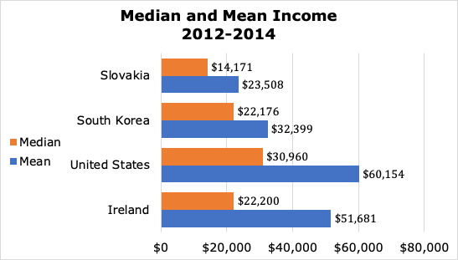
13.2.1 Warm-Up: Income
The diagram below shows bar charts for the median and mean income between 2012 and 2014 in selected countries. The income is given in U.S dollars ($).
volume 2, pg. 240

Slide 7
What do you notice about the values for median and mean income?
Why do you think the mean income for the U.S. was so much higher than the median income?
volume 2, pg. 240

Slide 8

Collaboration
volume 2, pg. 240

Slide 9

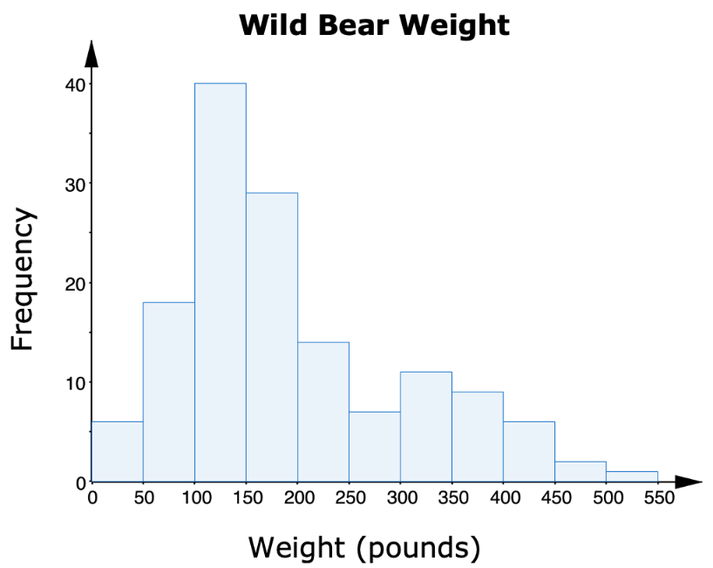
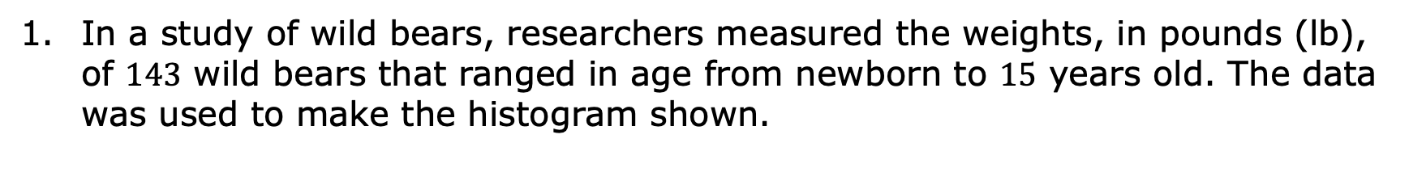
13.2.2 Collaboration: Center and Variation in Context
In a study of wild bears, researchers measured the weights, in pounds (lb), of $143$ wild bears that ranged in age from newborn to $15$ years old. The data was used to make the histogram shown.
volume 2, pg. 240

Slide 10
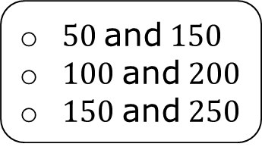
Complete the statements.
Based on the data, it appears wild bears typically weigh between pounds. A good estimate for the typical weight for wild bears is __________ pounds.
$50$ and $150$
$100$ and $200$
$150$ and $250$
volume 2, pg. 240

Slide 11
Compare your estimate with your partner. Discuss whether it is possible for both of your estimates to be reasonable, even if they are not the same.
Discuss with your partner whether your estimate from Part A is closer to the median or the mean. Summarize your discussion.
volume 2, pg. 241

Slide 12
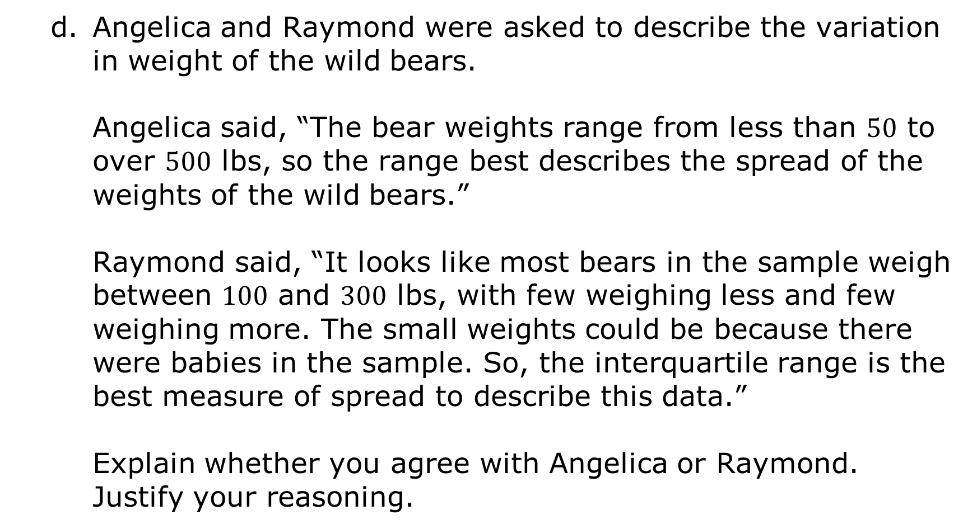
Angelica and Raymond were asked to describe the variation in weight of the wild bears.
Angelica said, “The bear weights range from less than $50$ to over $500$ lbs, so the range best describes the spread of the weights of the wild bears.”
Raymond said, “It looks like most bears in the sample weigh between $100$ and $300$ lbs, with few weighing less and few weighing more. The small weights could be because there were babies in the sample. So, the interquartile range is the best measure of spread to describe this data.”
Explain whether you agree with Angelica or Raymond. Justify your reasoning.
volume 2, pg. 241

Slide 13
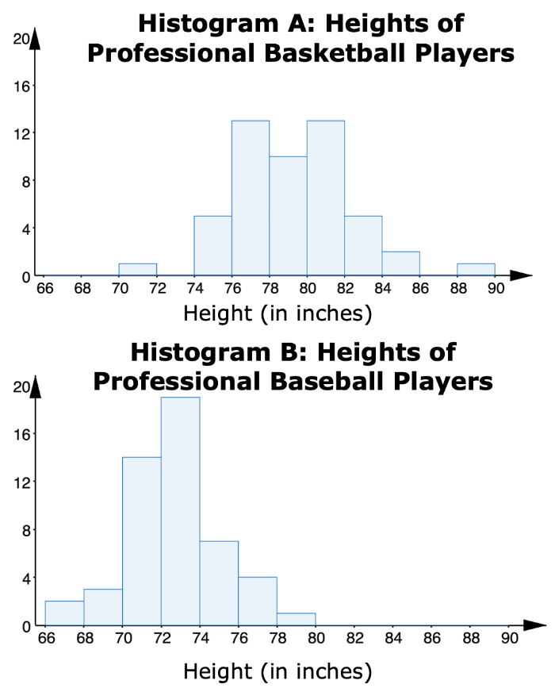
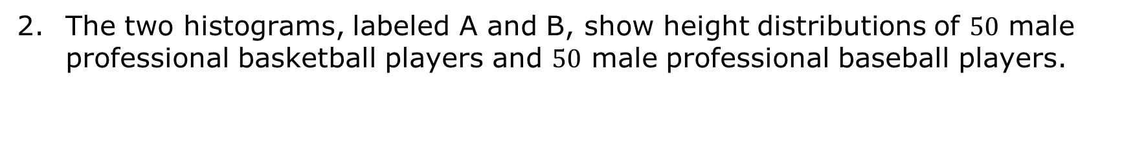
The two histograms, labeled A and B, show height distributions of $50$ male professional basketball players and $50$ male professional baseball players.
volume 2, pg. 241

Slide 14
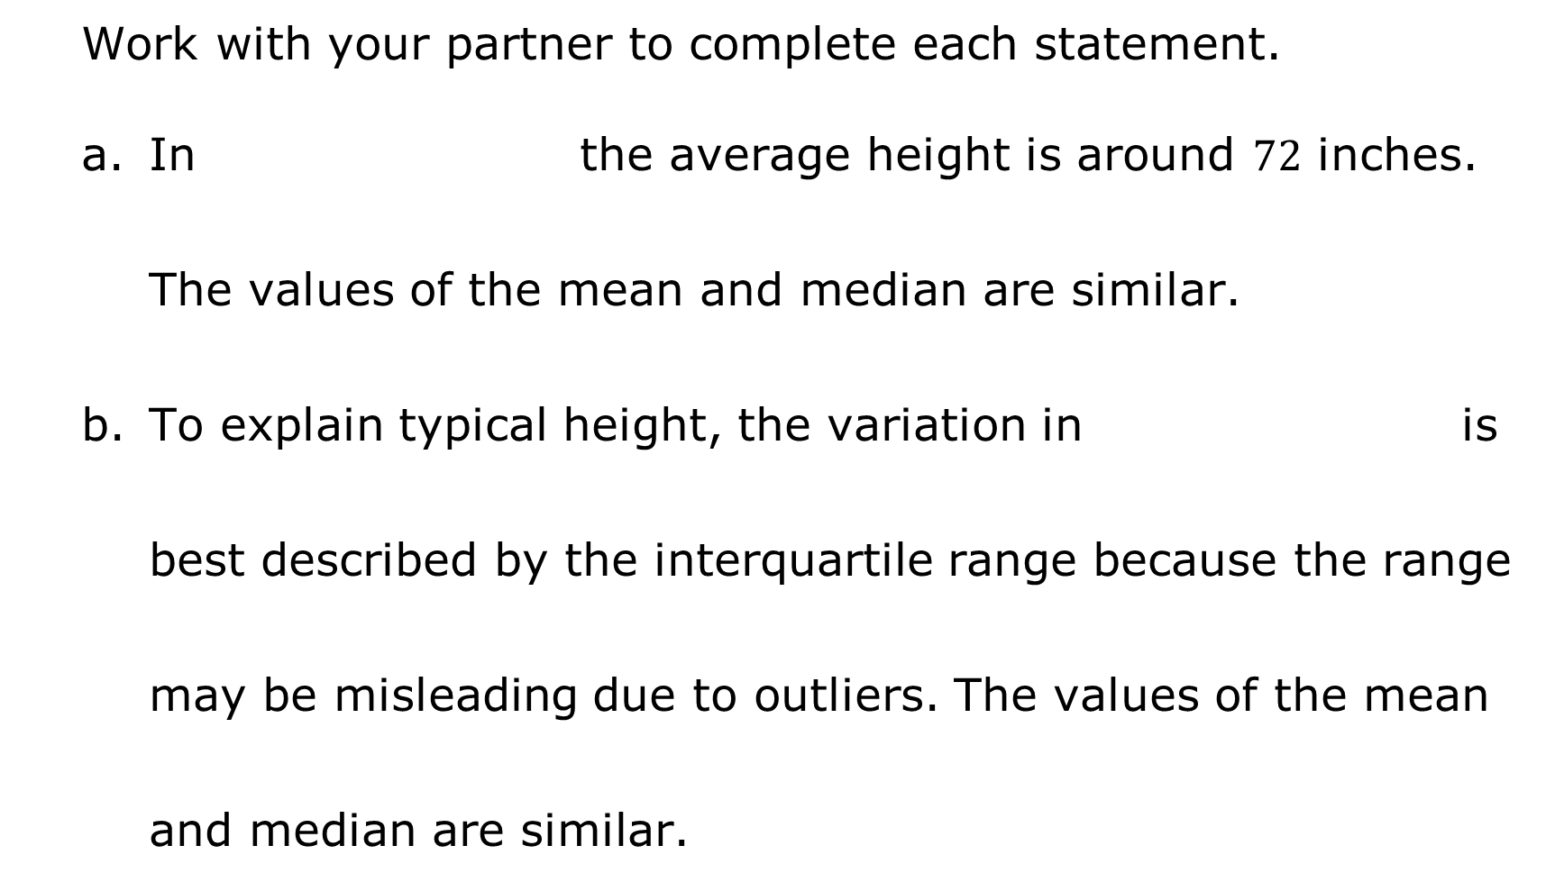
Work with your partner to complete each statement.
In the average height is around $72$ inches. The values of the mean and median are similar.
To explain typical height, the variation in is best described by the interquartile range because the range may be misleading due to outliers. The values of the mean and median are similar.
Histogram A,
Histogram B,
Histogram A
Histogram B
volume 2, pg. 241

Slide 15
An earthworm farmer set up several containers of a certain species of earthworm so he could learn about their lengths. Lengths of earthworms provide information about their ages. The farmer measured the lengths of the earthworms in one container.
The farmer displayed the earthworms’ lengths, in millimeters (mm), in a stem-and-leaf plot.
volume 2, pg. 242

Slide 16
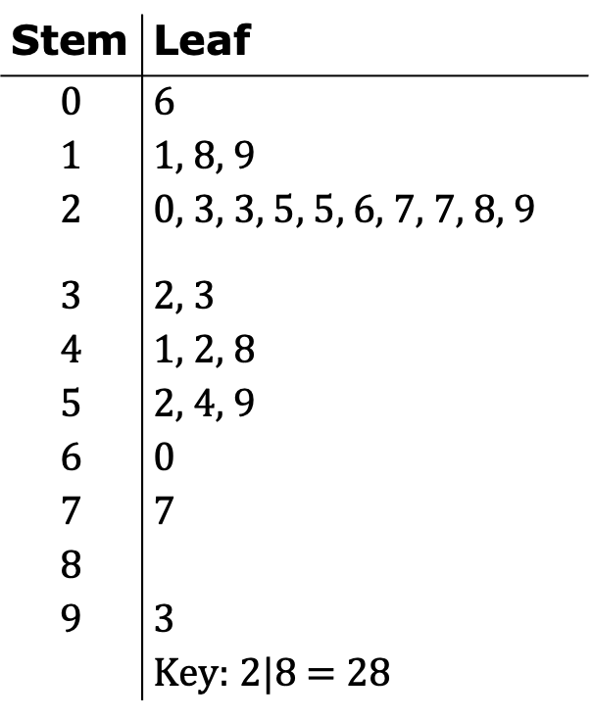
Use the display to answer the
following questions.
Half of the earthworms sampled were less than
________ mm long.
Stem | Leaf
$$0$$ | 6
$$1$$ | 1, 8, 9
$$2$$ | 0, 3, 3, 5, 5, 6, 7, 7, 8, 9
$$3$$ | 2, 3
$$4$$ | 1, 2, 8
$$5$$ | 2, 4, 9
$$6$$ | 0
$$7$$ | 7
$$8$$
$$9$$ | 3
 | Key: $2$|8 = 28
volume 2, pg. 242

Slide 17
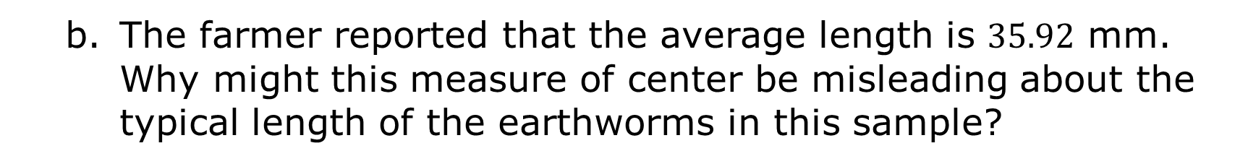
The farmer reported that the average length is $35.92$ mm. Why might this measure of center be misleading about the typical length of the earthworms in this sample?
volume 2, pg. 242

Slide 18
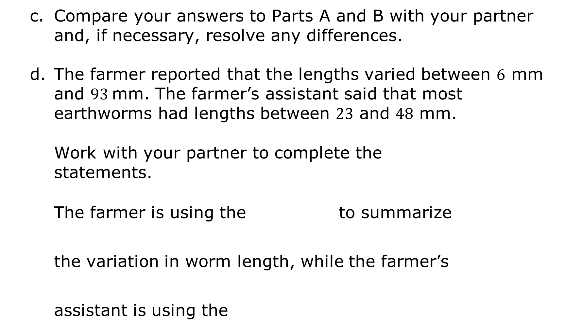
Compare your answers to Parts A and B with your partner and, if necessary, resolve any differences.
The farmer reported that the lengths varied between $6$ mm and $93$ mm. The farmer’s assistant said that most earthworms had lengths between $23$ and $48$ mm.
Work with your partner to complete the
statements.
The farmer is using the to summarize the variation in worm length, while the farmer’s assistant is using the
IQR
range
IQR.
Range.
volume 2, pg. 242

Slide 19
If a researcher is interested in how long earthworms are, the is an appropriate measure of variation for the farmer to report because .
IQR
range
volume 2, pg. 242

Slide 20

Bring It Together
volume 2, pg. 243

Slide 21

13.2.3 Bring It Together: Outlier Effects
Complete each statement to describe the effect outliers have on each measure of center or variation.
The presence of an outlier does not have a significant effect on the
The presence of an outlier will change, often significantly, the value of the
mean.
median.
mean.
median.
volume 2, pg. 243

Slide 22

The presence of an outlier does not have a significant effect on the
The presence of an outlier will change, often significantly, the value of the
IQR.
Range.
IQR.
Range.
When outliers are present or a distribution is skewed, the _______________ is the preferred measure of center and the ____________ is the preferred measure of variation to describe the distribution. However, the context must be considered because outliers may be important in understanding the data.
volume 2, pg. 243

Slide 23

Guided Practice
volume 2, pg. 243

Slide 24


13.2.4 Guided Practice: Comparing Distributions
Below is a line plot of the number of goals scored by the top $15$ women goal scorers during the 2019-2020 NCAA Women’s Division $1$ soccer season.
Number of Goals
2019-2020 NCAA Women’s Division 1 Soccer Top Scorers
volume 2, pg. 243

Slide 25
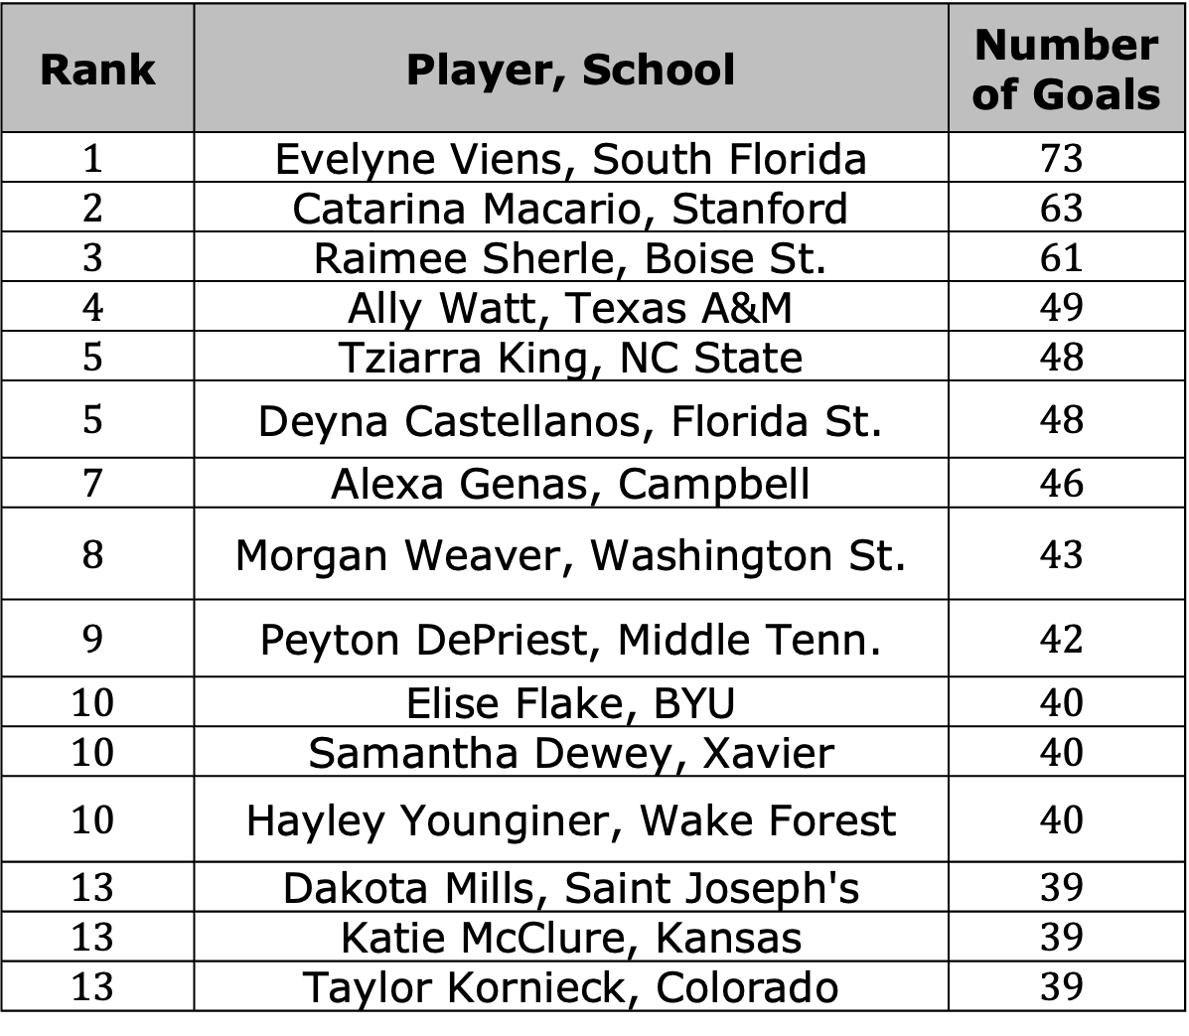
Rank | Player, School | Number of Goals
$$1$$ | Evelyne Viens, South Florida | $$73$$
$$2$$ | Catarina Macario, Stanford | $$63$$
$$3$$ | Raimee Sherle, Boise St. | $$61$$
$$4$$ | Ally Watt, Texas A&M | $$49$$
$$5$$ | Tziarra King, NC State | $$48$$
$$5$$ | Deyna Castellanos, Florida St. | $$48$$
$$7$$ | Alexa Genas, Campbell | $$46$$
$$8$$ | Morgan Weaver, Washington St. | $$43$$
$$9$$ | Peyton DePriest, Middle Tenn. | $$42$$
$$10$$ | Elise Flake, BYU | $$40$$
$$10$$ | Samantha Dewey, Xavier | $$40$$
$$10$$ | Hayley Younginer, Wake Forest | $$40$$
$$13$$ | Dakota Mills, Saint Joseph's | $$39$$
$$13$$ | Katie McClure, Kansas | $$39$$
$$13$$ | Taylor Kornieck, Colorado | $$39$$
volume 2, pg. 243

Slide 26
Without doing any calculations, explain which measure of central tendency you expect to be larger, the mean or the median.
Find the mean number of goals.
Find the median number of goals.
volume 2, pg. 244

Slide 27
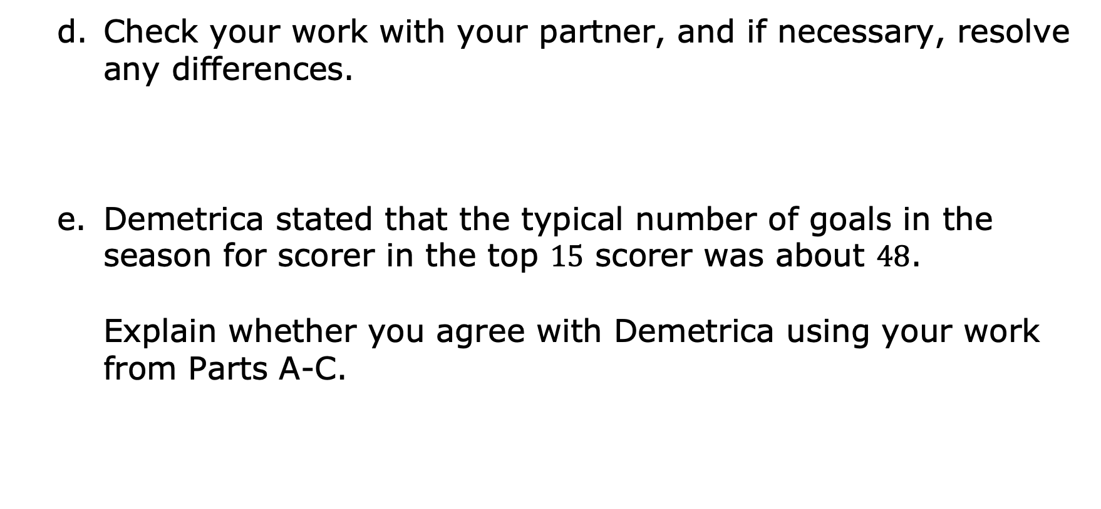
Check your work with your partner, and if necessary, resolve any differences.
Demetrica stated that the typical number of goals in the season for scorer in the top $15$ scorer was about $48$.
Explain whether you agree with Demetrica using your work from Parts A-C.
volume 2, pg. 244

Slide 28
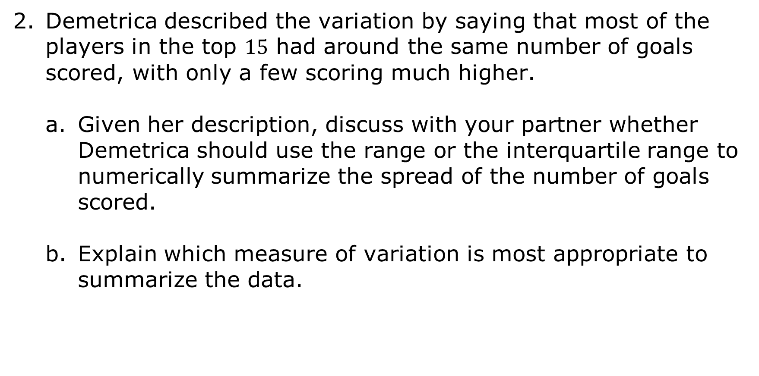
Demetrica described the variation by saying that most of the players in the top $15$ had around the same number of goals scored, with only a few scoring much higher.
Given her description, discuss with your partner whether Demetrica should use the range or the interquartile range to numerically summarize the spread of the number of goals scored.
Explain which measure of variation is most appropriate to summarize the data.
volume 2, pg. 244

Slide 29
At times, a statistical purpose may justify using a particular measure to describe the data.
Complete the statement.
If the statistical purpose of collecting the data is to determine how high the very top scorers score, the would be the most appropriate measure to use because this information is not captured in the
IQR
Range
IQR.
Range.
volume 2, pg. 244

Slide 30

Wrap-Up
volume 2, pg. 245

Slide 31
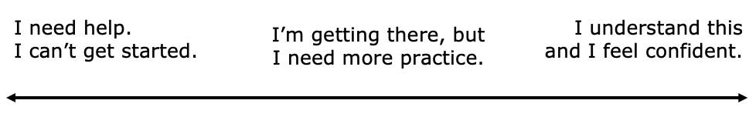
13.2.5 Wrap-Up: Reflection
Draw an X on the line to indicate where your current learning is in relation to the following learning targets.
I can justify whether or not a measure of center appropriately summarizes data.
volume 2, pg. 245

Slide 32
I can justify whether or not a measure of variation appropriately summarizes data.
volume 2, pg. 245

